Slide 1
Pivotal Cloud Foundry
Martez Killens
April 25, 2018
Notes:
I’m Martez Killens a Senior Platform Architect with Pivotal.
I specialize in .NET technologies and how they tie into the Pivotal Cloud Foundry Narrative.

Slide 2
Why do you need to be good at software?
Customers expect it.
Meet the demands to operate at scale.
Give you more business options.
Your competitors are improving.
It makes your life better.
Notes:
You MUST be good at software!
Customer expect it. No loyalty, people switch based on experience. Massage app experience.
Meet the demands to operate at scale: Keep growing operations? Home Depot not hiring
Being good at software presents business opportunities. Innovation takes an idea and execution, GM Maven-rent a car, Tmobile-Tuesdays
Competitors. Amazon, Google Apple on one End. Uber start ups on the other side. Albertsons
Selfish. Great time to be building software, tons of innovation, should be fun. Love to code

Slide 3
Improved speed. Faster cycle time, more frequent deployments.
Improved scale. More requests per second to apps and services.
Improved stability. Greater uptime of customer-facing service.
Improved security. Achieving 100% patch coverage.
Improved savings. Lower cost per unit of deployed compute.
Ok, but how do I know that I’m getting better at software?
Notes:
How do you determine that your getting better?
You must have metrics! CIO measures productivity by “Oh Craps”
Speed. Not just style sheet changes, actually deploying code. Turn around on defects or tickets. Time to implement a feature or get something into QA hands. Make changes and roll them back?
Are we adjusting to scale as we create more software and expose more parts of the system? Can we handle unexpected bursts? People expect stability today different world. Google Load Balancer or Amazon Prime Day
How do we measure security. Do you say I’m 90% more secure than last year? How old are credentials? How many patch cycles am I behind on the app, dependencies and servers? Composing apps, Function service lots of code
IT savings…money doesn’t go away but adding productivity. We double productivity from 40% to 80% then that’s more work getting done by fewer people. Not hiring. Scales well at enterprise

Slide 4
What keeps you from being good at software?
It’s hard to experiment and quickly incorporate what we learn.
Stuck with incomplete or outdated application platforms.
Hostile processes and procedures make it painful to ship software.
Organization silos have competing priorities.
Notes:
So why don’t you have those metrics?
Experimentation tough. Long time to get a server?
Outdated platform…can have all the process in the world, six sigma, etc, deploy or compile in a timely fashion. No feedback loops.
Good at process at Pivotal but if you don’t have somewhere to deploy you’re going nowhere.
Shifting focus now. Not about making IT more efficient. And sometimes people have different incentives. Going nowhere until you make it about adding value for customer.
Adrian Crockcoft formerly of Netflix now AWS talks about journey from wont work, unicorns, to how? And he says I hired them from you because they were frustrated. No magic.

Slide 5


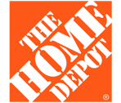


The transformation is real.
T-Mobile goes from 7 months and 72 steps to update software, to same day deployments.
Liberty Mutual builds and deploys an MVP in one month and delivers revenue-generating version just hours later.
The Home Depot ships to production 1,500 times a month, and 17,000 times a month to all environments.
Comcast supports over 1500 developers with an operator team of 4 people.
Express Scripts went from 45 days to patch one product in nine environments, to five days.
Notes:
Developer productivity improvements
The transformation is real! Real companies like you! Not snpchat adding a new filter
At Pivotal we’ve seen our partners make profound Digital Transformations!
We’ve seen T-mobile go from a 72 step, 7 month deployment down to same day deploys.
At Liberty Mutual we’ve seen them build an MVP in one month with revenue generating version a couple of months later
Comcast supports a large development team with just a few operators
Home Depot ships to production 1500 times a month and 17,000 times across all environments
Digital transformations are happening! We’re seeing them across are partners at over 1/3 of the fortune 100.
We’re helping transform
7 of the largest banks
9 of the largest automakers
7 of the largest insurers
8 of the largest retailers
9 of the largest telcos

Slide 6
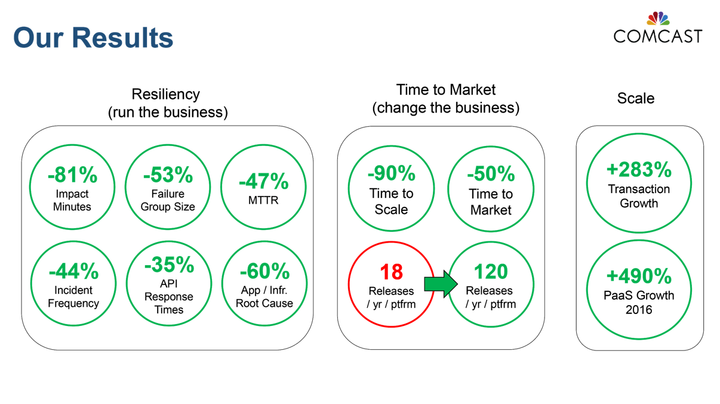
Comcast: Stability, Speed, Scalability with PCF
1,500+ Developers
5,000+ Applications
4-6 Operators
210M Daily Transactions
2X Faster Time to Market
80% Better Resiliency
10X Faster to Scale
25% ‘Oxygen’ increase
Source: Greg Otto, Executive Director, Cloud Services at Comcast, CF Summit June 2017
Notes:
Mean Time to Recovery – Important
Releases
Scale
Real life and measurable.

Slide 7
The Pivotal value proposition
Developer Productivity
Operational Efficiency
Comprehensive Security
High Availability
Accelerate feedback loops by improving delivery velocity
Focus on applications, not infrastructure
Give developers the tools and frameworks to build resilient apps
Employ 500:1 developer to operator ratio
Perform zero-downtime upgrades
Runs the same way on every public/private cloud
Adopt a defense-in-depth approach
Continuously update platforms to limit threat impact
Apply the 3 R’s → repair, repave, rotate
Run platforms that stays online under all circumstances
Scale up and down, in and out, through automation
Deploy multi-cloud resilience patterns
Notes:
So we’ve talked a little bit about digital transformation! And the question is how do we get there?
So there’s four things Pivotal offers across all of our products that enables this transformative journey. Developer Productivity, Operational Efficiency, Security and High Availability.
Developer Productivity
We’re helping you be more effective with your development time. We’re making sure that developers are getting to more important things quickly. They’re getting into work that matters.
As you’re moving faster we have many feedback loops. These feedback loops lead to velocity. Not only are you moving faster but you’re moving in a direction. Moving fast is efficient and changing direction is effective learning.
Operational Efficiency
Operational efficiency matters for everything we build, that what people expect when they come to us. Operators are able to do more without incrementally or exponentially growing their operations team. Are we keeping the systems online by helping operators doing zero downtime upgrades? Not trying to figure out can I roll this out, get a maintenance window over the weekend.
Security
Security wise, you come to Pivotal and you expect a best of class security approach. We have extensive monitoring tooling but it runs deeper than that. We’re changing the paradigm where we are a dynamic infrastructure that actively thwarts bad actors that want to compromise us. When you come to any of our products, the idea is that you’re getting a security approach that’s long lasting and protective.
High Availability
Pivotal products just do not go down. With PCF, we’ve heard from customers…the layers of resiliency built in…there will always be things that fail, any complex distributed system is always in a state of continuous partial failure, disks are failing, network latency occurs, an app crashes. It’s inevitable. That’s not something to worry about but something more so that you welcome because it creates hardened systems.
We are making your dev teams better, your ops team do more, getting better with security while building systems that won’t go down.

Slide 8
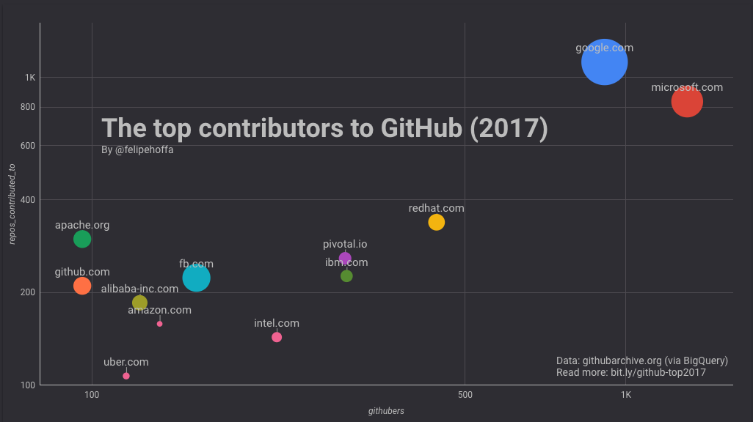

Pivotal invests heavily in open-source software
“Pivotal is currently contributing as much software to open source projects as IBM.”
Source: https://redmonk.com/jgovernor/2017/10/25/some-thoughts-on-the-top-contributors-to-github-2017/
Notes:
We’re a software company and we give you choice! On we’re all over the scene.
So you come to Pivotal because you expect commercialization support, patchin and gluing it all together.

Slide 9
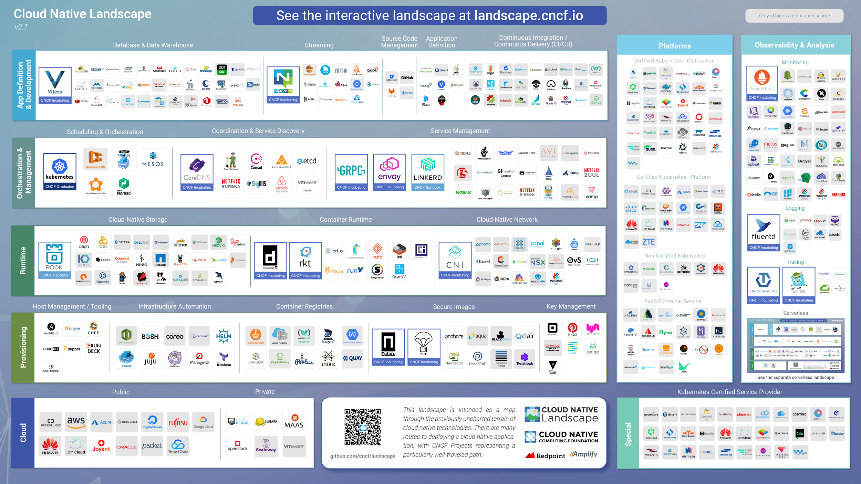
!!!
Notes:
Cloud Native Computing Foundation, Pivotal along with VM Ware and Dell are the largest contributors!
This is what makes up cloud native. You can debate this section for a month and add no business value.
Pivotal is opinionated and we’ve taken the best of Cloud Native and turned it into PCF!

Slide 10
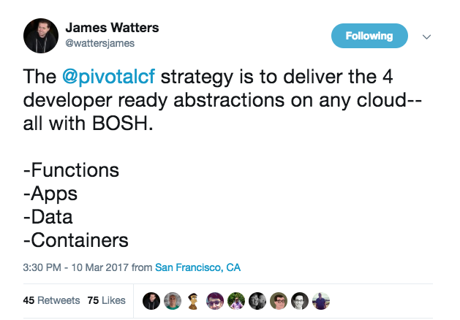

Slide 11
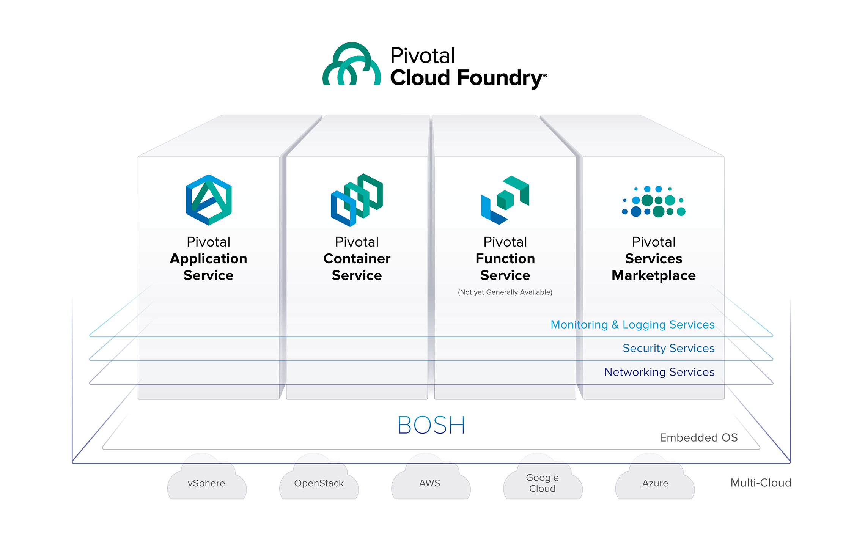
Any App Every Cloud One Platform
PCF 2.2 – for everything that matters
Notes:
Any App Every Cloud One Platform
When you look at a modern application platform the idea is how are we running all of the different things our customers want to run wherever they want to be, rather you’re on premises, rather you’re in the public cloud or you’re at the edge. The idea is that I want one way to run the different types of applications my data center has. I’ve got a long lived web application, I’ve got short lived responsive event driven things that could be functions, I’ve got packaged platforms and software that deploy to Kubernetes. How can I get a consistent experience, a single set of promises, how can I get one operational control plane to keep this stuff running. The answer is PCF especially as you get into a marketplace where you can attach additional services from the eco-systems.
We talked about the four promises, Developer productivity, operator efficiency, comprehensive security and high availability.
Developers get the right tool for the job, operations and infosec get one platform to manage it all across the enterprise.
This all backed by BOSH and the multicloud promises that it makes.
Pivotal Services marketplace makes it easy for you to extend your applications and containers with dozens of brand name technology providers that can compliment your applications, that can give you a database, give you a message queue, give you an API gateway.

Slide 12
The Developer DREAM Haiku
Here is my source code,
Run it in the Cloud for me,
I do not care how
Notes:
Just do it!
Transition to demo

Slide 13

No More Tickets — Self-Service Provision and Deploy
Code Complete & Tested
cf push
Find available hosts
Install & configure runtime
Install & configure middleware
Pull application source code
Retrieve dependent libraries
Create application package
Install, configure dependent service(s)
Deploy container to host(s)
Load environment variables
Configure load balancer
Configure firewalls
Update service monitoring tools
Configure log collector
2 Days
1 Day
1 Day
¼ Day
¼ Day
¼ Day
2 Days
½ Day
¼ Day
2 Days
2 Days
3 Days
1 Day
Speed &
Consistency
~45 seconds
Application in Production
~15+ Days
Notes:
I want you to think about your current workflow and what it takes as an operator to deploy and run a brand new application…
Provision a VM
Configure IP, DNS
Configure firewall
Windows updates, reboot…
Install IIS
Deploy application
Configure app pool
Configure SSL
Configure load balancer
We did all of this without entering a support ticket. All we needed was a Pivotal Cloud Foundry account with enough quota headroom to deploy this application.
Not all of these things take as long as the right side states. In many cases it may only take 15 seconds or so but sitting in a queue, waiting for approvals, etc.

Slide 14
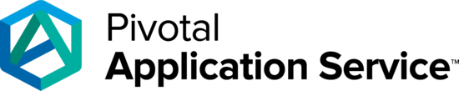
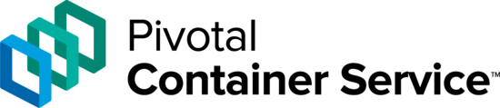
Decide what you want to “own” from security perspective
DIY k8s or container stack
App Team provided
Application Layer
Application Layer
Application Layer
Service Brokerage
Service Brokerage
Service Brokerage
App Team Provided
Runtime Layer
Runtime Layer
App Team Provided
Runtime Layer
Platform Provided
OS Image
OS Image
OS Image
Embedded OS
Platform Provided
Embedded OS
Embedded OS
Notes:
What do you care about managing?
Just your application.
How do you feeling about patching? The OS, Runtimes, etc?
Worrying about PODS, Clusters, updating Kubernetes. Coming up with a DIY solution that only works for your company?

Slide 15
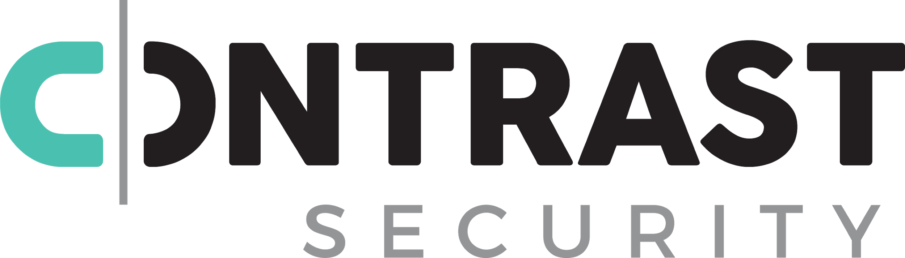

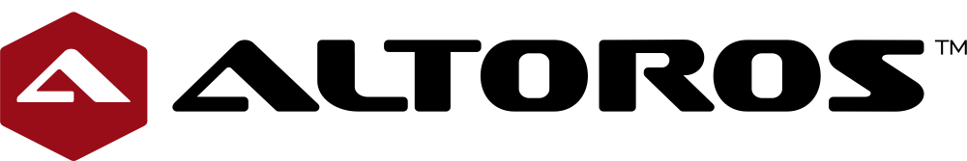
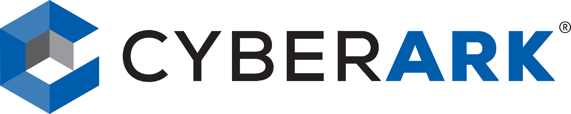


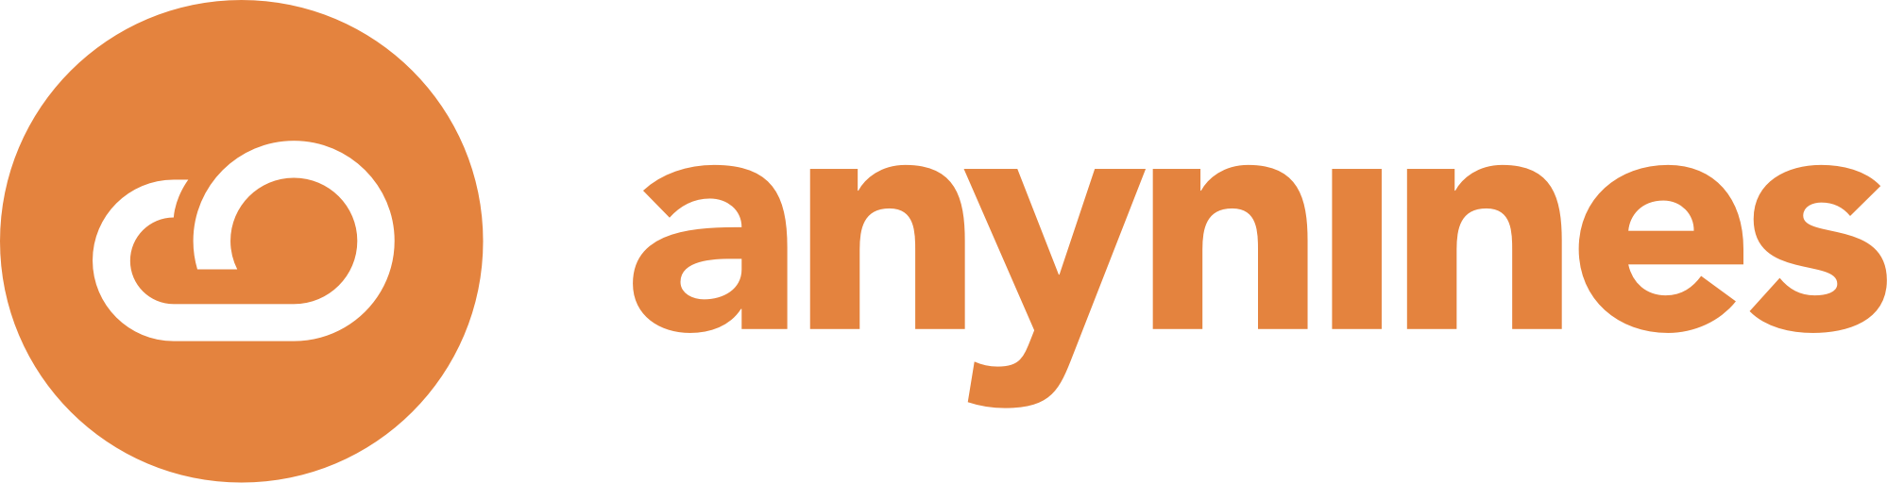
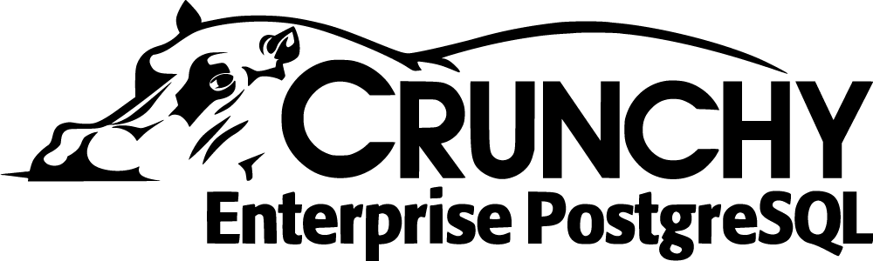

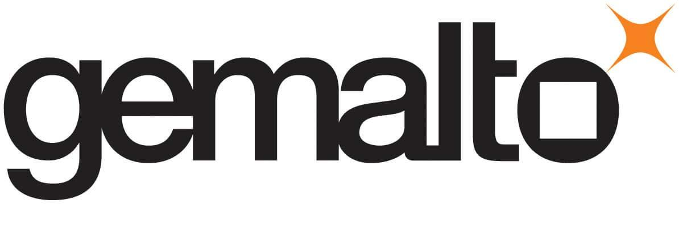
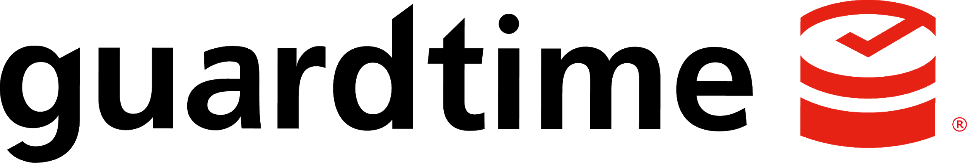

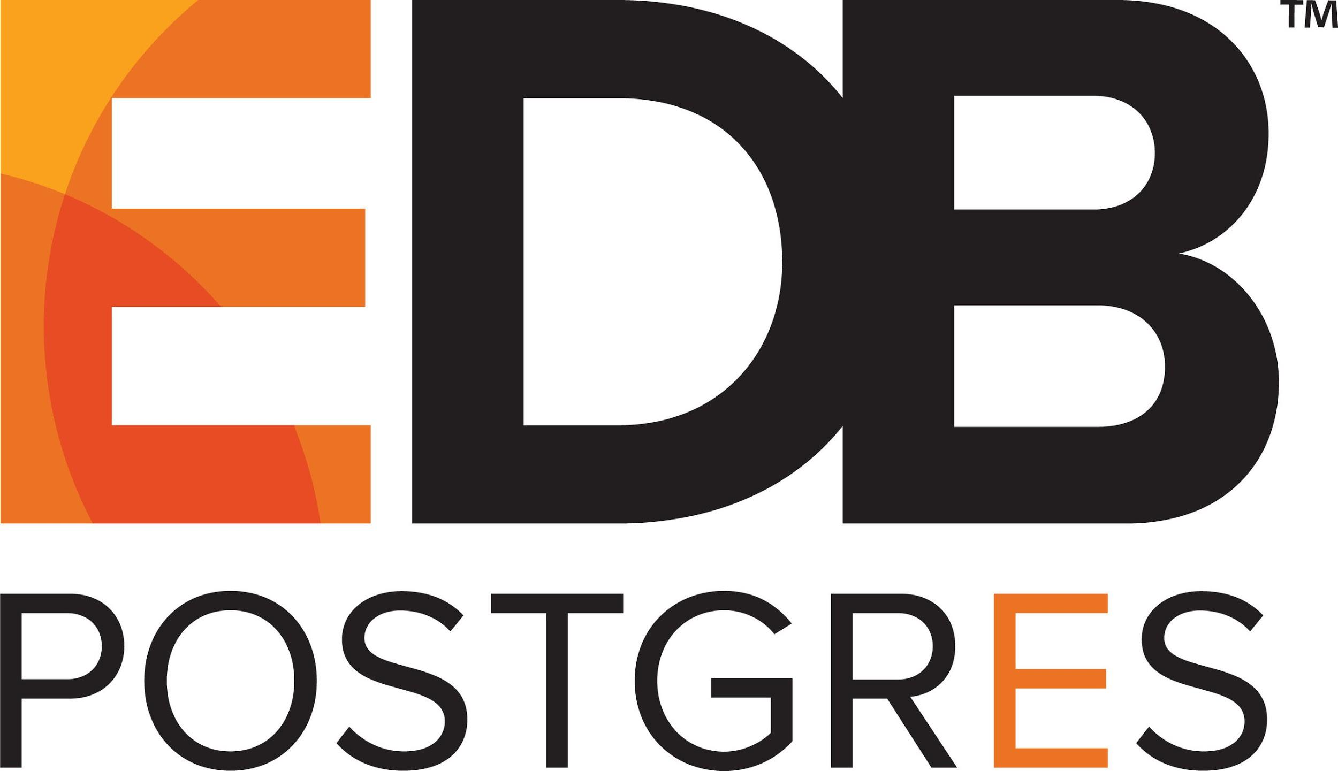





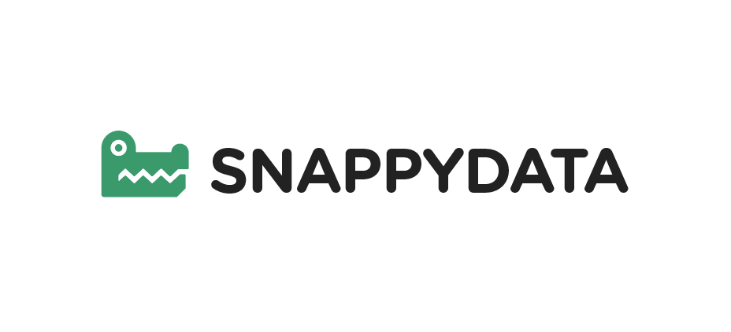
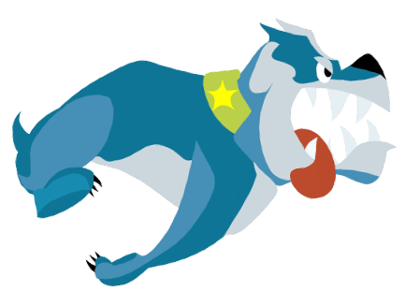
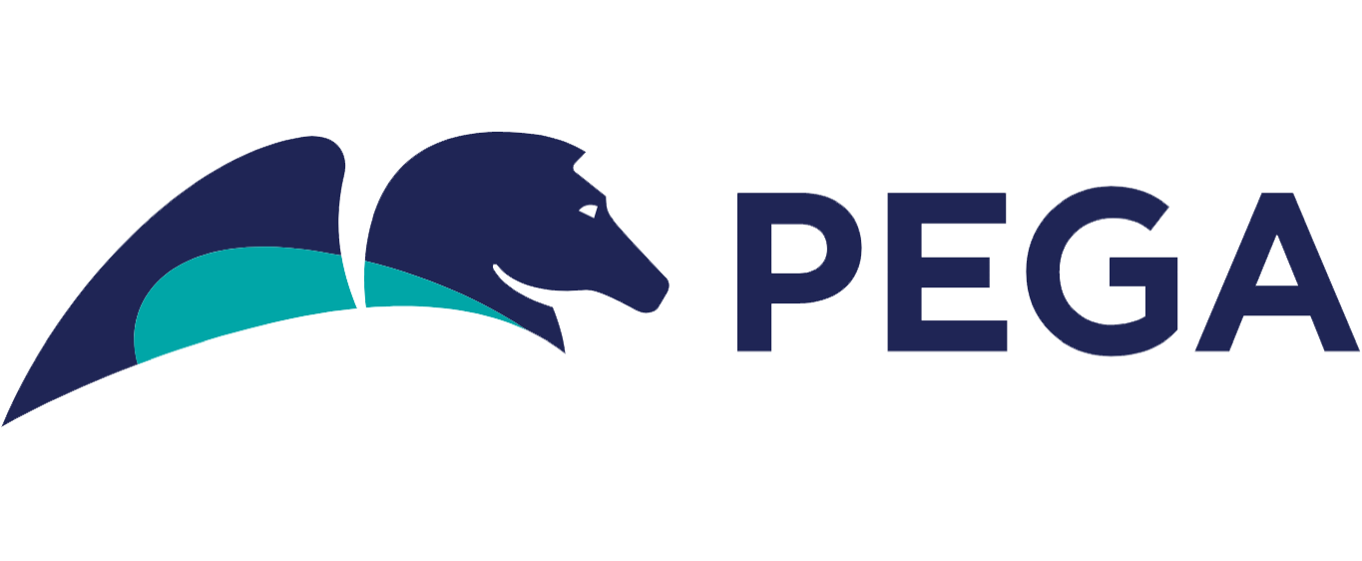



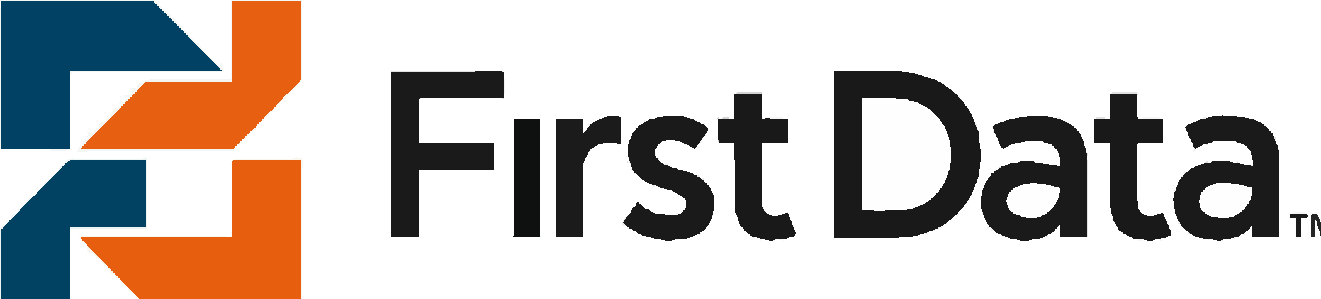
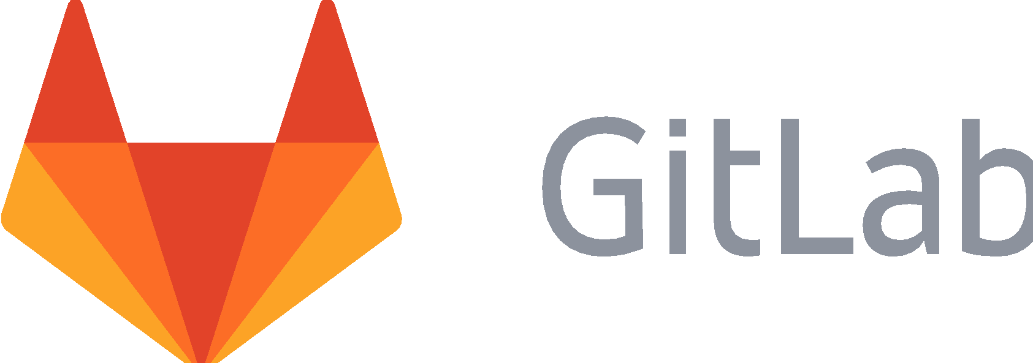
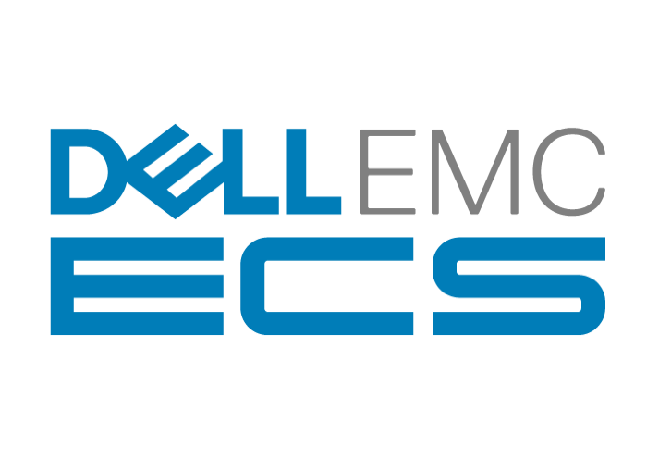

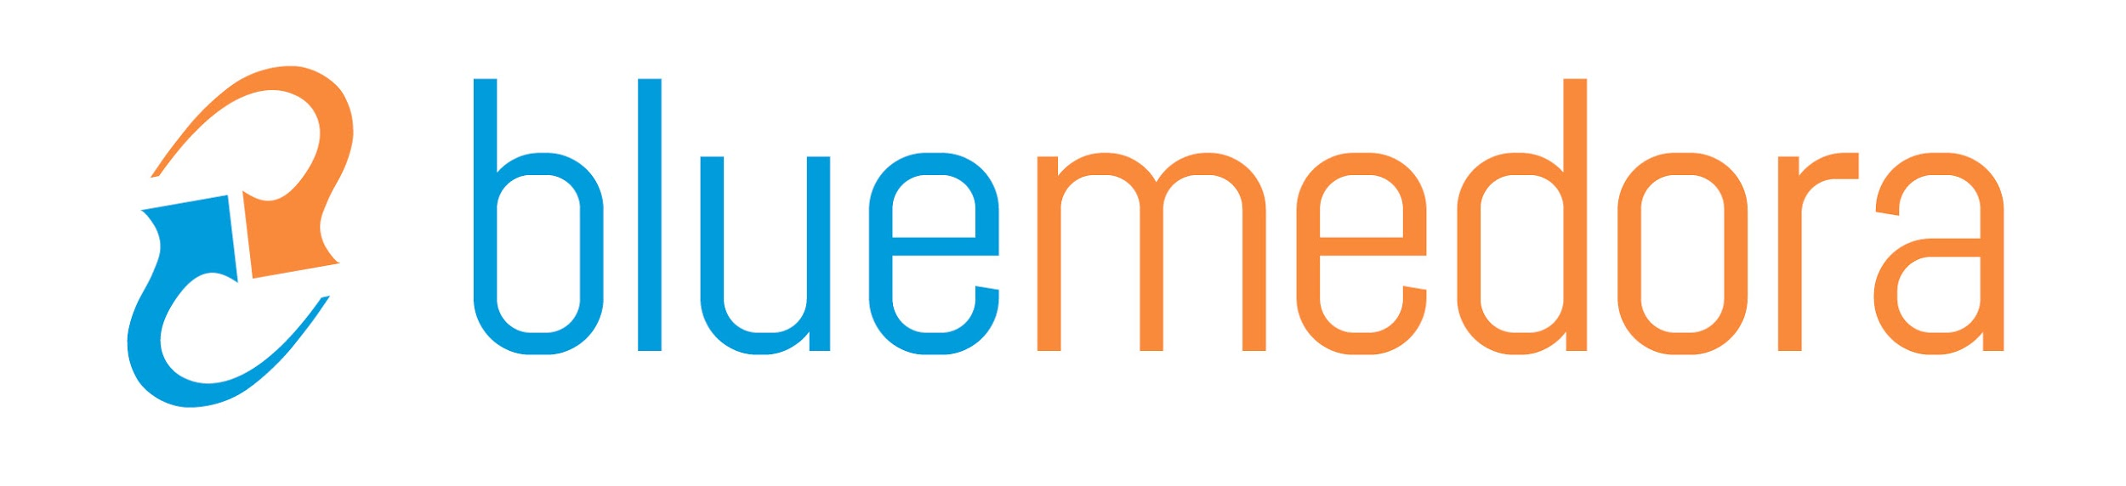
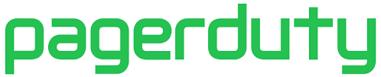
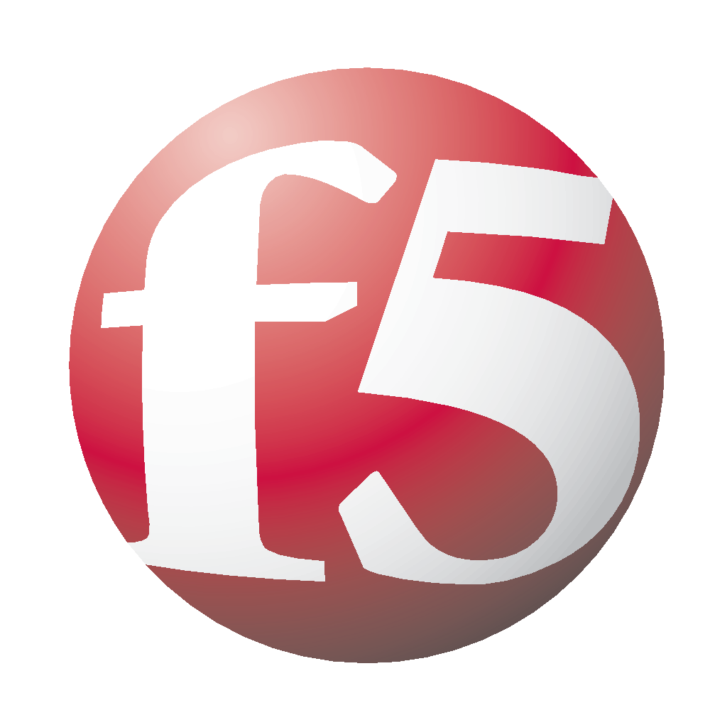
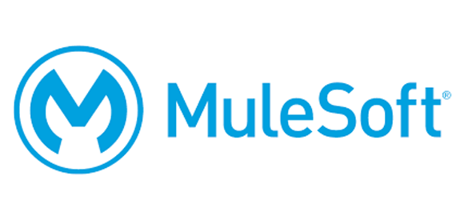
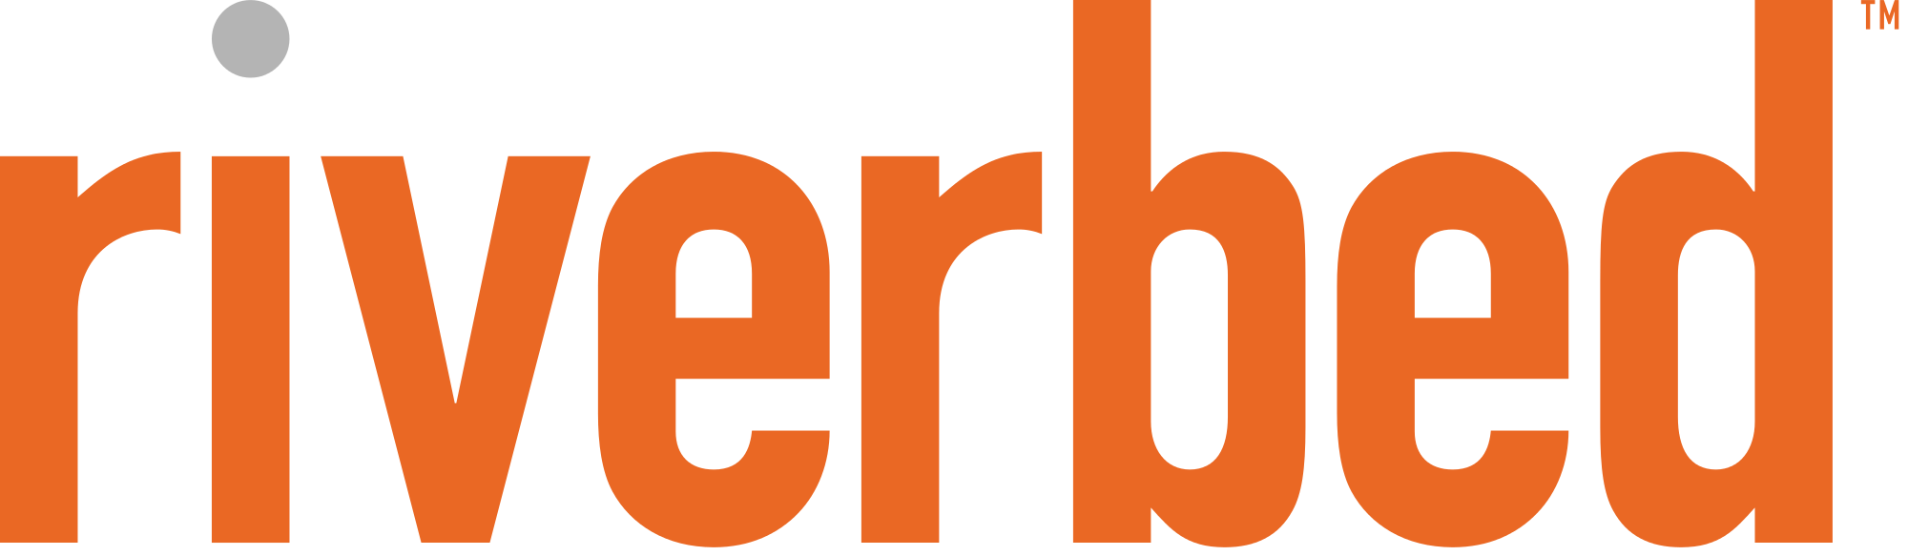
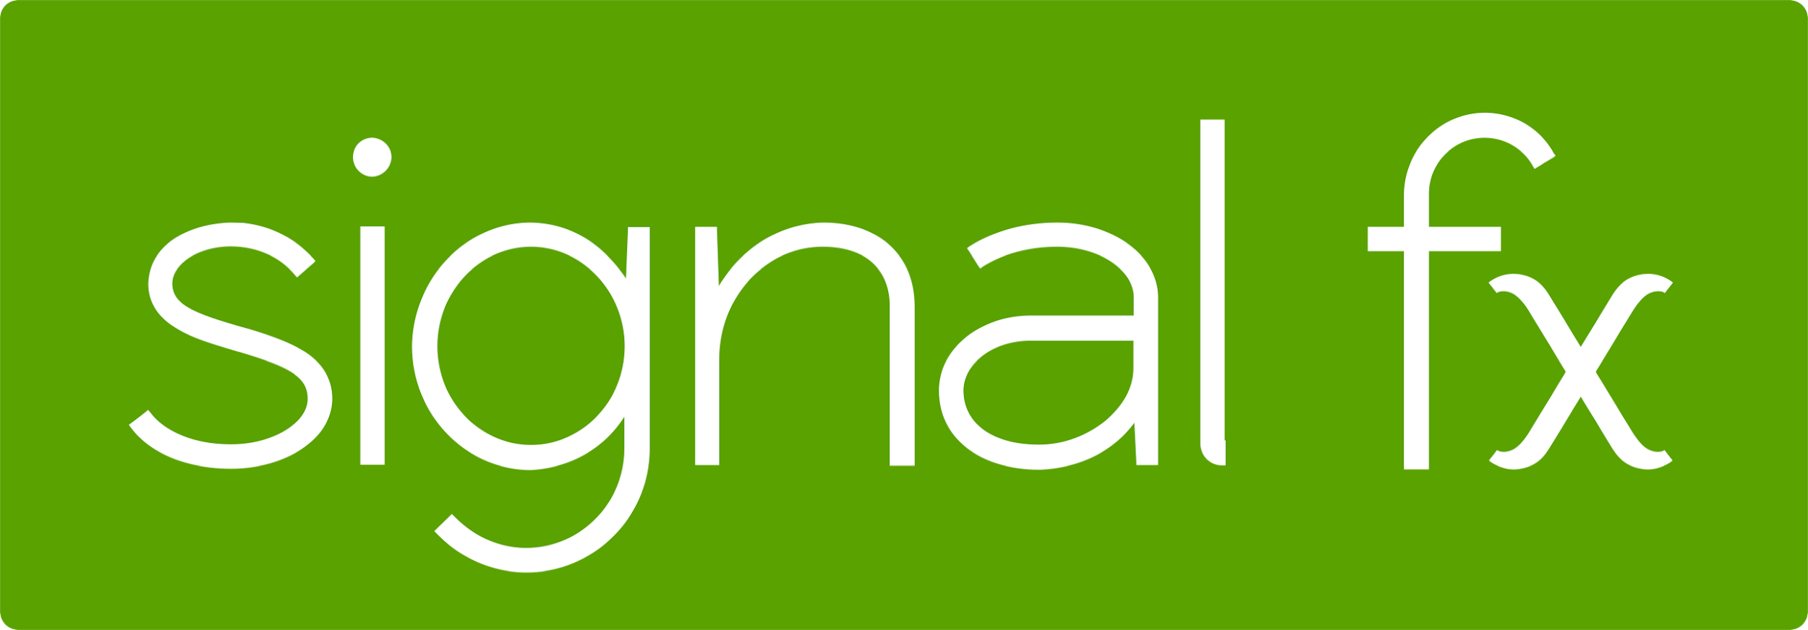
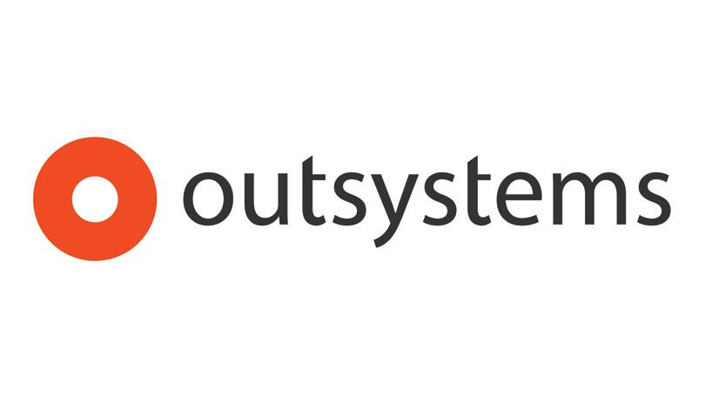
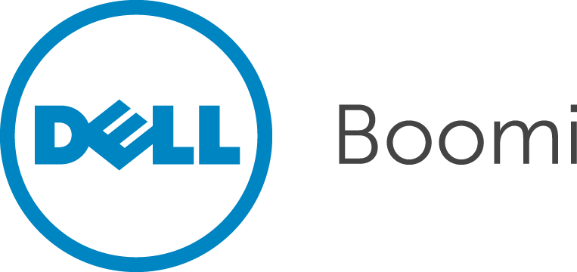

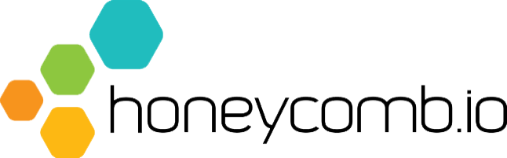
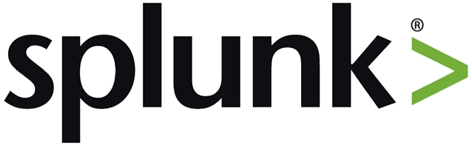
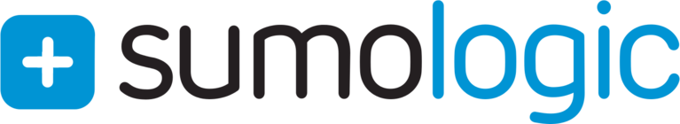
ISV Ecosystem Momentum Drives Platform Advantage
Google Cloud Platform
ETL
SECURITY
DATABASE
ITIL
IAM
IaaS
Microsoft Azure
BPM
TEST
CACHE / LB
SEARCH
NETWORKING
COMMERCE
IDE/CODE
CI / CD
BATCH
MOBILE
API / SOA /
uS / IOT
ANALYTICS
APM
MESSAGING
SIEM / LOG /
AUDIT
Microsoft Azure
Google Cloud Platform
CRM
Notes:
We can’t do it along.
Customer driven set of integrations points.
One common experience and not a ton of different servers running custom software. Making it simpler for you

Slide 16
Pivotal ushers in four paradigm changes
Moving fast to stay safe. Instead of constantly battling unpatched infrastructure and inconsistent credential handling, embrace the 3 R’s realized through a security-first platform.
Cloud-native Java and .NET. Spring. Steeltoe, and Cloud Foundry move companies away from monolithic, hard-to-change systems towards resilient, composable microservices that get continuously delivered.
System—not server—automation. Move from server-driven automation towards platform-managed systems that are self-healing, updated constantly, and serve up the abstractions that developers care about.
Multi-cloud for the enterprise. Switch from COE per cloud with unique experiences for each, to consistent dev and ops processes regardless of infrastructure pool.
Alternatives to the status quo
Notes:
Turn-key compliance - security should be built-in from the ground up, not bolted on later.
Repair vulnerable software as soon as updates are available. Equifax system wouldn’t have been compromised in the first place. Repave servers and applications from a known good state. Do this often. For Equifax once the system was compromised the actors would have had only a short shelf life to find credentials and compromise data
Rotate user credentials frequently, so they are only useful for short periods of time. For Equifax, once the system is compromised any credentials they were able to obtain would likewise be short lived (minutes and hours) which would reduce the threat window.
Cloud native Java and .NET innovation on the java front is being driven at Pivotal with spring, spring cloud and boot. And as an extension of that Steeltoe.
Cloud Foudry is a plafrom and it’s not giving you server automation. Here is a server instead it’s saying this vm is a one of three hosts and we need to keep things available don’t bring all three down at one time.
Cloud choice is the last thing you think about. It doesn’t matter run on gcp, azure, on prem hybrid scenarios.

Slide 17

Everything you need to transform
Data / AI
Process & Culture
Build for change
Pivotal Labs
Culture, tools, and platform
Tools
Continuously Improve
Apps
Tracker / Spring / Concourse
Platform
Any App, Every Cloud, One Platform
PCF 2.1
Notes:
Pivotal is in a unique position
Quite a few company’s that do a great job of helping you with process and culture. Many consulting companies that do strong work in helping companies think about how they build their products and companies.
Plenty of tools out there for continuously improving in the development space, CI/CD
There’s also a ton of Platforms out there. Amazon and others who give you a place to run stuff.
I contend that any one or two of these three are not sufficient.
I can have a great process but what good is that if I’m using outdated tools I’ll be woefully behind competitors
I can have amazing tools but if my teams can’t collaborate and there’s no place to run things it’s a waste of time.
I can have a great platform but if I’m deploying bad products I achieve nothing.
We’re at a unique nexus at Pivotal were being able to help people build things the right way, using the right tools and running in the right spot helps you build change that sticks!

Slide 18

Transforming How The World Builds Software
© Copyright 2017 Pivotal Software, Inc. All rights Reserved.

